Slide 1

Introduction
to
Computer Science
CS101.3
Lecture #02

Slide 2
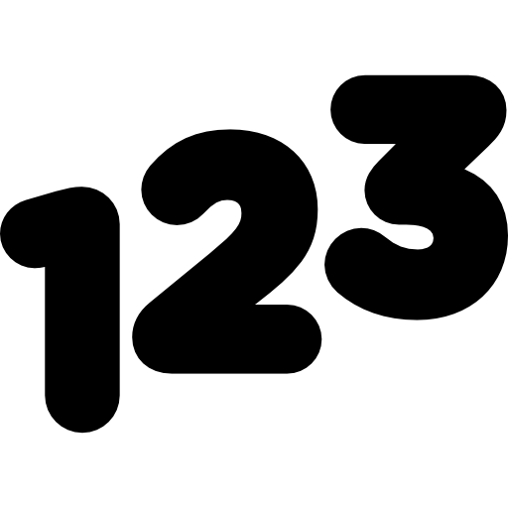
Number Systems
The technique to represent and work with numbers is called number system.
Decimal number system is the common number system which used to do day to day arithmetic operations.
Other popular number systems are Binary number system, Octal number system, Hexadecimal number system etc.

Slide 3
Decimal Number System
Decimal number system is a base 10 number system which having 10 digits from 0 to 9.
This means that any numerical quantity can be represented by using these 10 digits.
Decimal number system is a positional value system which means that the value of digits will depend on its position.

Slide 4
Decimal Number System
Positional value system
(Example)
Assume that we have number 456
In 456,
Value of 4 is 4 hundreds or 400 or 4 x 100 or 4 x 10²
Value of 5 is 5 tens or 50 or 5 x 10 or 5 x 10
Value of 6 is 6 units or 6 or 6 x 1 or 6x 10⁰
Means that 456 = 400 + 50 + 6

Slide 5

Decimal Number System
Weightage / Place values
The weightage of each position can be represented as follows

Slide 6
Binary Number System
In Digital systems, instructions are given through electric signals.
Signal variation is done by varying the voltage of the signal
When considering decimal number system having 10 different voltages to implement digital signals is difficult.
The easiest way to vary instruction through electric signals is two state process know as ON & OFF
ON represent 1 and OFF represent 0
The number system having just these two digits are know as Binary number system

Slide 7

Binary Number System
In binary number system each binary digit is also called a bit.
Binary number system is also positional value system, where each digit has a value expressed in power of 2.
8 bits = 1 byte
1 1 0 1 0 1 0 1₂

Slide 8
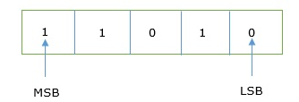
Binary Number System
In any binary number, the rightmost digit is called least significant bit (LSB) and the leftmost digit is called most significant bit (MSB)

Slide 9
Converting Decimal number to Binary number
When converting a decimal number which in base 10 to binary number which in base 2, should follow certain steps. 2
Once you get the decimal value divide that number from 2 and mention the remainder value.
Then divide again that by 2 and mention the remainder value.
Follow the same process until you get 1 or 0.
Then write down all remainder values starting from most recent remainder value.

Slide 10
Converting Decimal number to Binary number
Example
Convert 13 decimal to binary number
2 13
2 6 1
2 3 0
1 1
1101₂

Slide 11
Converting Decimal number to Binary number
Exercise
Convert following decimal numbers to their binary equivalent
23
63
11
0

Slide 12
Converting Decimal number to Binary number
Answers
10111₂
111111₂
1011₂
0₂

Slide 13
Converting Binary number to Decimal number
Decimal of following binary number is sum of product of each digit with its positional value.
Example
11010₂
₁ ₁ ₀ ₁ ₀
1×2⁴ + 1×2³ + 0×2² + 1×2¹ + 0×2⁰
= 16 + 8 + 0 + 2 + 0
= 26₁₀

Slide 14
Converting Binary number to Decimal number
Exercise
Convert following Binary numbers to their Decimal equivalent
110111₂
111110₂
10111₂
0110₂

Slide 15
Binary Calculations
By using binary number system, it’s capable of performing arithmetic operations such as decimal number system.
In this module we are focusing on Binary addition and binary subtraction.

Slide 16
Binary Addition
Binary addition is the easiest of the processes to perform.
As you'll see with the other operations below, it is essentially the same way you learnt to do addition of decimal numbers by hand (probably many years ago in your early school years).
The process is actually easier with binary as we only have 2 digits to worry about, 0 and 1.

Slide 17
Binary Addition
Example 01
Assume that you have to add 10101₂ and 00101₂
1 0 1 0 1 21
0 0 1 0 1 5
1 1 0 1 0 26
1
1

Slide 18
Binary Addition
Example 02
Assume that you have to add 10101₂ and 111₂
1 0 1 0 1 21
1 1 1 7
1 1 1 0 0 28
1
1
1

Slide 19
Binary Subtraction
Example 01
Assume that you have to subtract 01001₂ from 10101₂
1 0 1 0 1 21
0 1 0 0 1 9
0 1 1 0 0 12
1 set is equal to 2 bits
1

Slide 20
Binary Subtraction
Example 02
Assume that you have to subtract 101₂ from 10101₂
1 0 1 0 1 21
1 0 1 5
1 0 0 0 0 16

Slide 21
Binary Calculations
In Class Quiz
Task – Perform following calculations and upload your answers to given link in LMS
File format – word document or notepad file
Add following binary numbers | Subtract following binary numbers
10100₂ + 10101₂ | 1001₂ - 1000₂
11100₂ + 10011₂ | 10011₂ - 01110₂
11010₂ + 1011110₂ | 1111₂ - 100₂
101010₂ + 1111₂ | 10010₂ - 00011₂

Slide 22
On next week
Octal Number System
Octal number system calculations
Thank You !

